Slide 1


Climate action Road Map
St. James Episcopal Climate Action Committee​​
Prepared for:​​

Slide 2

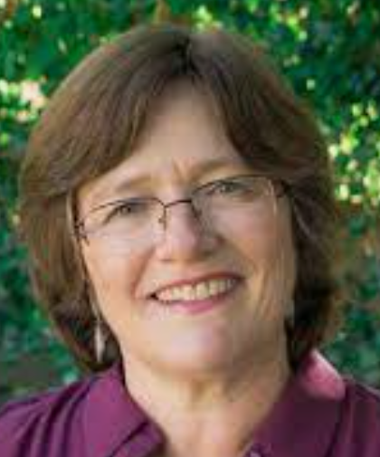
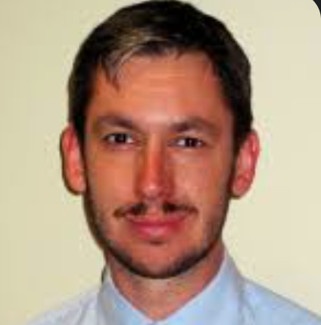


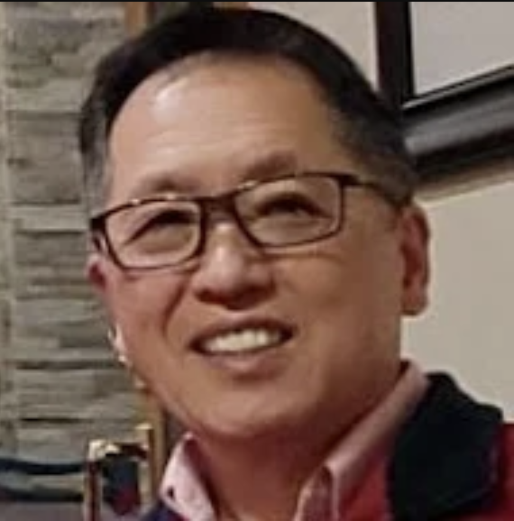
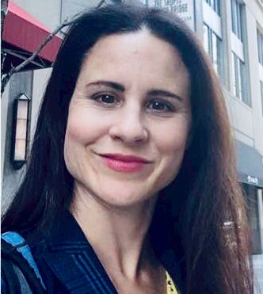

About us
Dr. Lucy Jones was asked to join the Bishop’s Committee on Disaster Resiliency and Climate Change. St. James Episcopal Church in South Pasadena, CA is a test bed for climate action strategy and implementation that can be applied to other parishes. This document is a road map to position the church as a resiliency hub addressing emergency preparedness, climate change and restorative justice to surrounding communities.
STRATEGY & GRANT FUNDING
Harry Allen
Lisa Markus
LOCAL ACTIONS
Gay Almquist
Richard B. Lewis III
Edmond Yee
COMMUNICATIONS & SENTIMENT RESEARCH
Lindsey Angelats
Katie Clark
Dr Lucy Jones
Lead

Slide 3
OUR APPROACH
The St. James Climate Action Committee met and divided work into the following workstreams:
QUICK WINS
MAINTAIN MOMENTUM
STRATEGY
STRATEGIC PARTNERSHIPS & FUNDING
Identifying local efforts that are high benefit, low effort
Picking up where past disaster preparedness, emergency planning effort left off
Start developing a longer-term carbon reduction strategy & plan
Shape funding sources through feedback, uncover federal and local grants and resources, and form strategic partnership to leverage utility and other funding mechanisms

Slide 4
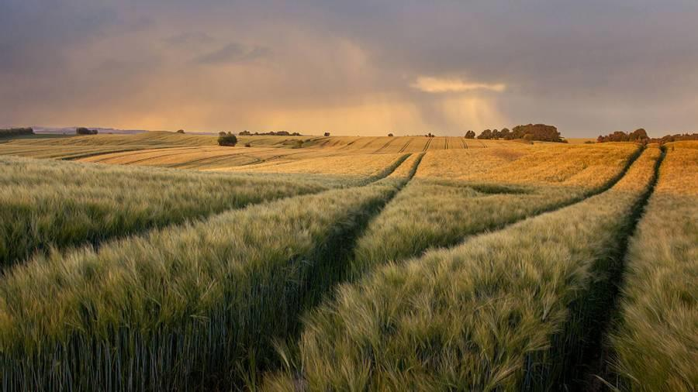
Quick Wins

Slide 5
Quick Wins
TOPIC | TACTICS
Core Team & Congregation Gets CERT / FEMA Basic Training CERT Team | South Pasadena, CA (southpasadenaca.gov) Community Emergency Response Team (CERT) | FEMA.gov | CERT is a community based group of volunteers that have completed a federally recognized training course taught by Public Safety personnel and First Responders. The training is a comprehensive program detailing the ways to assist friends, family, co-workers and the community in a small or large scale disaster - March 18, 25 and April 1 2023 at 8:00am to 1:00pm each day - South Pasadena Fire Department (817 Mound Avenue, South Pasadena) ACTION: Have Fire Captain lecture at SAGES
Consider designing “Food Locker” as an official ministry | SB 1383 is legislation to reduce greenhouse gasses and increase food security among vulnerable populations by diverting usable food from landfills. St James operates the Food Locker under the umbrella of Union Station, who has paid staff and manages the administration / reporting associated with food operations to feed the poor. Consider developing a plan to expand Food Locker into an official ministry by leveraging SB 1383 funds to expand operations and have paid positions
Move Church landscaping to drought-tolerant plants | Sarin Assadvazadorian (Parish School Director) to schedule demonstration children’s garden of CA native plants in our patio such as with milkweed for monarch butterflies Oscar Madrigal (Youth Center Director) to plan youth participation with our CA natives plantings and maintenance by offering us a demonstration table at the upcoming Science Night Talk to Rev Michelle and Jimmy about migration to drought-tolerant plants in church landscaping
Core Team & Congregation commit to water conservation, energy efficiency and waste reduction actions | Learning about programs and develop action plan that congregation can be engaged in: https://www.southpasadenaca.gov/government/departments/management-services/environmental-programs https://www.southpasadenaca.gov/government/departments/public-works/environmental-programs/sustainable-south-pasadena/south-pasadena-green-action-plan https://www.southpasadenaca.gov/government/departments/public-works/environmental-programs/sustainable-south-pasadena/climate-action-plan
First step is to identify high benefit, low effort activities to jump start climate action. The following were generated by St. James Climate Action Committee members Quick Win Workstream…
On-Call Environmental Consulting Services (southpasadenaca.gov)

Slide 6
LOCAL PLANNING
START BY SURVEYING YOUR PARISH CAMPUS…
We may have grown accustomed to how our parish campus ‘looks and feels’. The trees and planters, shrub rows and ground covers, patios and parking lots, become familiar to us and possibly cherished as the milieu of our communal lives. However, we increasingly understand that these familiar environs can be at odds with ecological imperatives around water quality and flood safety, energy use, light and noise pollution, toxic chemicals, the urban heat island effect, equitable and safe access, sustainable building and maintenance materials, multi-modal transportation infrastructure, diminishing habitat values for wildlife, mental/public health, and other key issues for a sustainable built and natural environment. Most importantly, we have the opportunity to demonstrate in three-dimensions our commitment to equitable and sustainable life to honor God and represent his welcoming care in our world.
In addition to global consciousness and action around climate change, it is vital that Episcopalians practice sustainability at the local level—in our own homes, businesses, communities, and parish campuses.
Water wise
Drought Tolerant
Heat Reducing
Community Engaging
CREATION SUSTAINING QUALITIES
On-Call Environmental Consulting Services (southpasadenaca.gov)

Slide 7
WATER WISE
Adopt smart water practices. Consider…
MANAGING Storm Water
Optimize on-site storm water retention and infiltration, minimize runoff, and cultivate healthy absorptive soils in planting areas to improve water quality, vegetation resilience, attenuate flooding, and aquifer recharge.
INSTALL Bio-Swales
Consider the installation of vegetated bio-swales to capture storm runoff—e.g., at the perimeter of parking areas and concrete patios.
.
HARVEST Rainwater
Consider the installation of rain barrels and underground cisterns to capture storm runoff for reuse in irrigating landscape areas.
Depending on bio-region, and the varying impacts of climate change on regional precipitation and extreme weather occurrence, practices around water safety and supply will vary. For example: In the Pacific Southwest region, a process of aridification is underway that requires an urgent re-envisioning of water ethics, with practical applications for local parishes.
INSTALL SMART Irrigation CONTROLLERS
Install ‘smart’ irrigation controllers, and water-wise sprinklers/emitters, to reduce water use. Strategically position emitters to focus water where needed and avoid wasteful overspray onto hardscape areas, and avoid applying excessive volume and frequency of irrigation
Infiltration
Explore options for replacing impervious paving (e.g., standard asphalt and concrete) with pervious surfacing materials.

Slide 8
Drought tolerant
Rethink parish vegetation to drought tollerant. Consider…
Going Native
Campus landscapes can be modified to include native plant species to provide habitat value for beneficial wildlife species such as butterflies, beetles, and hummingbirds. Native wildlife species have co-adapted to use the native plants of their region for their specific fruits/seeds, nectar, and other uses. Native landscapes can be just as attractive as landscapes based on exotic/non-native plantings, and they provide educational/interpretive opportunities to educate parishioners about local habitat resources. As noted above, plant selections should be adapted to the local climate in terms of water needs.
Campus vegetation can achieve multiple goals for aesthetic and sustainability, including important carbon sequestration processes to contribute to climate solutions. Progressive strategies and resources for reimagining campus landscapes can be developed in coordination with local native plant societies, water districts, plant nurseries, land conservancies, academic institutions such as university cooperative extensions, and qualified design and management professionals.
PLANTING ADAPTIVE Plants
Design or replace ecologically unsuitable parish landscapes with plant species/varieties selections that are adapted to the eco-region and can thrive with minimal to no inputs of artificial irrigation.
.
USING Turf Grass
Minimize turf grass cover to those areas that are actually needed for human activities and communal use, saving both water and the high energy inputs, and noise pollution, associated with maintaining turf (lawnmowers, etc.). Turf grass should not be installed or retained merely for aesthetic values; instead, utilize ecologically suitable ground cover vegetation.
.

Slide 9
HEAT REDUCING
The ‘urban heat island’ effect has a damaging impact on the biosphere including public health. When the sun directly shines on unvegetated surfaces such as asphalt and concrete, the hardscape or bare soil absorbs and also reflects this radiation (onto buildings, windows, etc.), resulting in persistent warming of urban spaces. In turn, such warming creates a greater need for energy-intensive cooling of indoor and outdoor spaces to protect public health. By optimizing the tree canopy cover on campuses, these warming effects are mitigated, as the trees’ leaves beneficially absorb the incident radiation. Studies have shown a correlation between the abundance of tree cover and human health in urban environments.
Right-Sizing of Plants
When selecting plant species, consider the mature sizes of trees and shrubs, and their overall habits (e.g., columnar, spheroid) to allow for their natural growth to maturity without need for pruning. This reduces green waste generation and avoids adverse impacts to wildlife such as nesting birds caused by pruning/shearing of vegetation.
Other considerations…
Fire-Safe Landscaping
Campus landscaping should be carefully designed and properly maintained to reduce wildfire hazards.
Safe Chemicals
Use organic and sustainable substances for pest control, fertilizers, and other landscape chemicals, and avoid the use of synthetic herbicides, to protect human health and wildlife such as pollinators.
Electric/Non-Gas-Powered Equipment
Maintain parish landscapes with ‘green’-rated electric equipment to the extent practicable, and avoid the use of polluting gas engines whose exhaust fumes adversely impact the health of landscape crews.
.

Slide 10
Community engaging
Engage the community in action and discussion including…
Engage the community inside and beyond the church in activities and blue sky discussions.
Explore ways to involve the church community in caring for on-site landscape areas, including ‘weeding days’, application of wildflower seed mixes, commemorative plantings of native trees, etc., to increase the people’s sense of knowledge and ‘ownership’ of these resources
Composting and Proper Green Waste Disposal
The parish should explore opportunities to compost pruned or mowed vegetation on site for re-application to local planters, saving the energy expenditure and expense associated with off-site disposal. If off-site disposal is necessary, the parish should explore opportunities to provide green water to local recycling entities.
Urban Agriculture
Imagine conversion of a portion of the campus to urban agriculture (e.g., raised bed vegetable gardens, fruit trees, vineyards) to address food insecurity in the community, and provide beneficial exercise and horticultural education opportunities
Urban Wildland
When properly designed and maintained, a ‘re-wilded’ landscape that supports beneficial native plants and wildlife provides a refuge within the urban/suburban grid that promotes human health, inspires spiritual reflection and sanctuary, welcomes the community into a space of peace and vibrant life, and demonstrates the eco-centric heart of the parish and wonderment at our Creator. These benefits can be obtained from even the smallest planter given mindful thought and care.

Slide 11
OTHER CONSIDERATIONS
Engage the community in discussion on…
CREATING A DARK SKY
Implement ‘dark sky’ practices on your campus, and advocate for the adoption of dark-sky programs in your local community/municipality. As stated by the International Dark-Sky Association: “…Artificial light at night has revolutionized the way we live and work outdoors, but it has come at a price. When used indiscriminately, outdoor lighting can disrupt wildlife, impact human health, waste money and energy, contribute to climate change, and block our view of the universe”. Resources are available on their website at www.darksky.org
REDUCING Noise Pollution
Practice noise reduction in landscape maintenance—e.g., avoid excessive, inconsiderate use of noisy equipment to promote public health and good community relations.
Explore ways to involve the church community in caring for on-site landscape areas, including ‘weeding days’, application of wildflower seed mixes, commemorative plantings of native trees, etc., to increase the people’s sense of knowledge and ‘ownership’ of these resources
Public Safety
Landscapes should be designed and maintained to promote public safety—e.g., avoiding dense areas of taller shrubs that can provide cover for unlawful activities.
Multi-Modal Transportation Resources
Install charging stations for electric vehicles where suitable.
Provide ample, clearly marked, and assertively enforced parking for the differently able.
Provide secure bicycle racks and lockers.
Optimize pedestrian safety…

Slide 12
INSIDE
Consider…
Design/Construction
Prioritize sustainability in design and construction, such as pursing accreditation under the Leadership in Energy and Energy Design (LEED) rating system of the U. S. Green Building Council: https://www.usgbc.org/leed
Sustainable Furnishings, Flooring, Coverings…
Safe, Sustainable, and Fully Bio-Degradable Cleaners, Solvents, and Other Chemicals…
Certified Organic, Fair Trade, and Locally-Sourced Food and Beverages…
Vegan and Vegetarian Resources…
Pre-owned Clothing and Textiles Exchanges.
As with the outdoor environment on the campus, we have grown accustomed to the appearance, amenities, and functions of the indoor parish environment, although many of these methods and materials are now known to be unsafe or unsustainable. This includes such materials as carpeting, heating and cooling equipment, cleaners and lubricants, types of lighting, equitable and safe physical access, types and sources of foods and beverages offered/prepared, kitchen appliances, waste disposal, paper products, water fountains, waste disposal components, and so on. Following are some issues and ideas to address in building design, maintenance, resource uses, and overall programming.
Energy Efficient Appliances. Install energy efficient appliances, fixtures, and devices such as those receiving Energy Star ratings by the U.S. Enviromental Protection Agency: https://www.energystar.gov/

Slide 13
Episcopal church

Slide 14
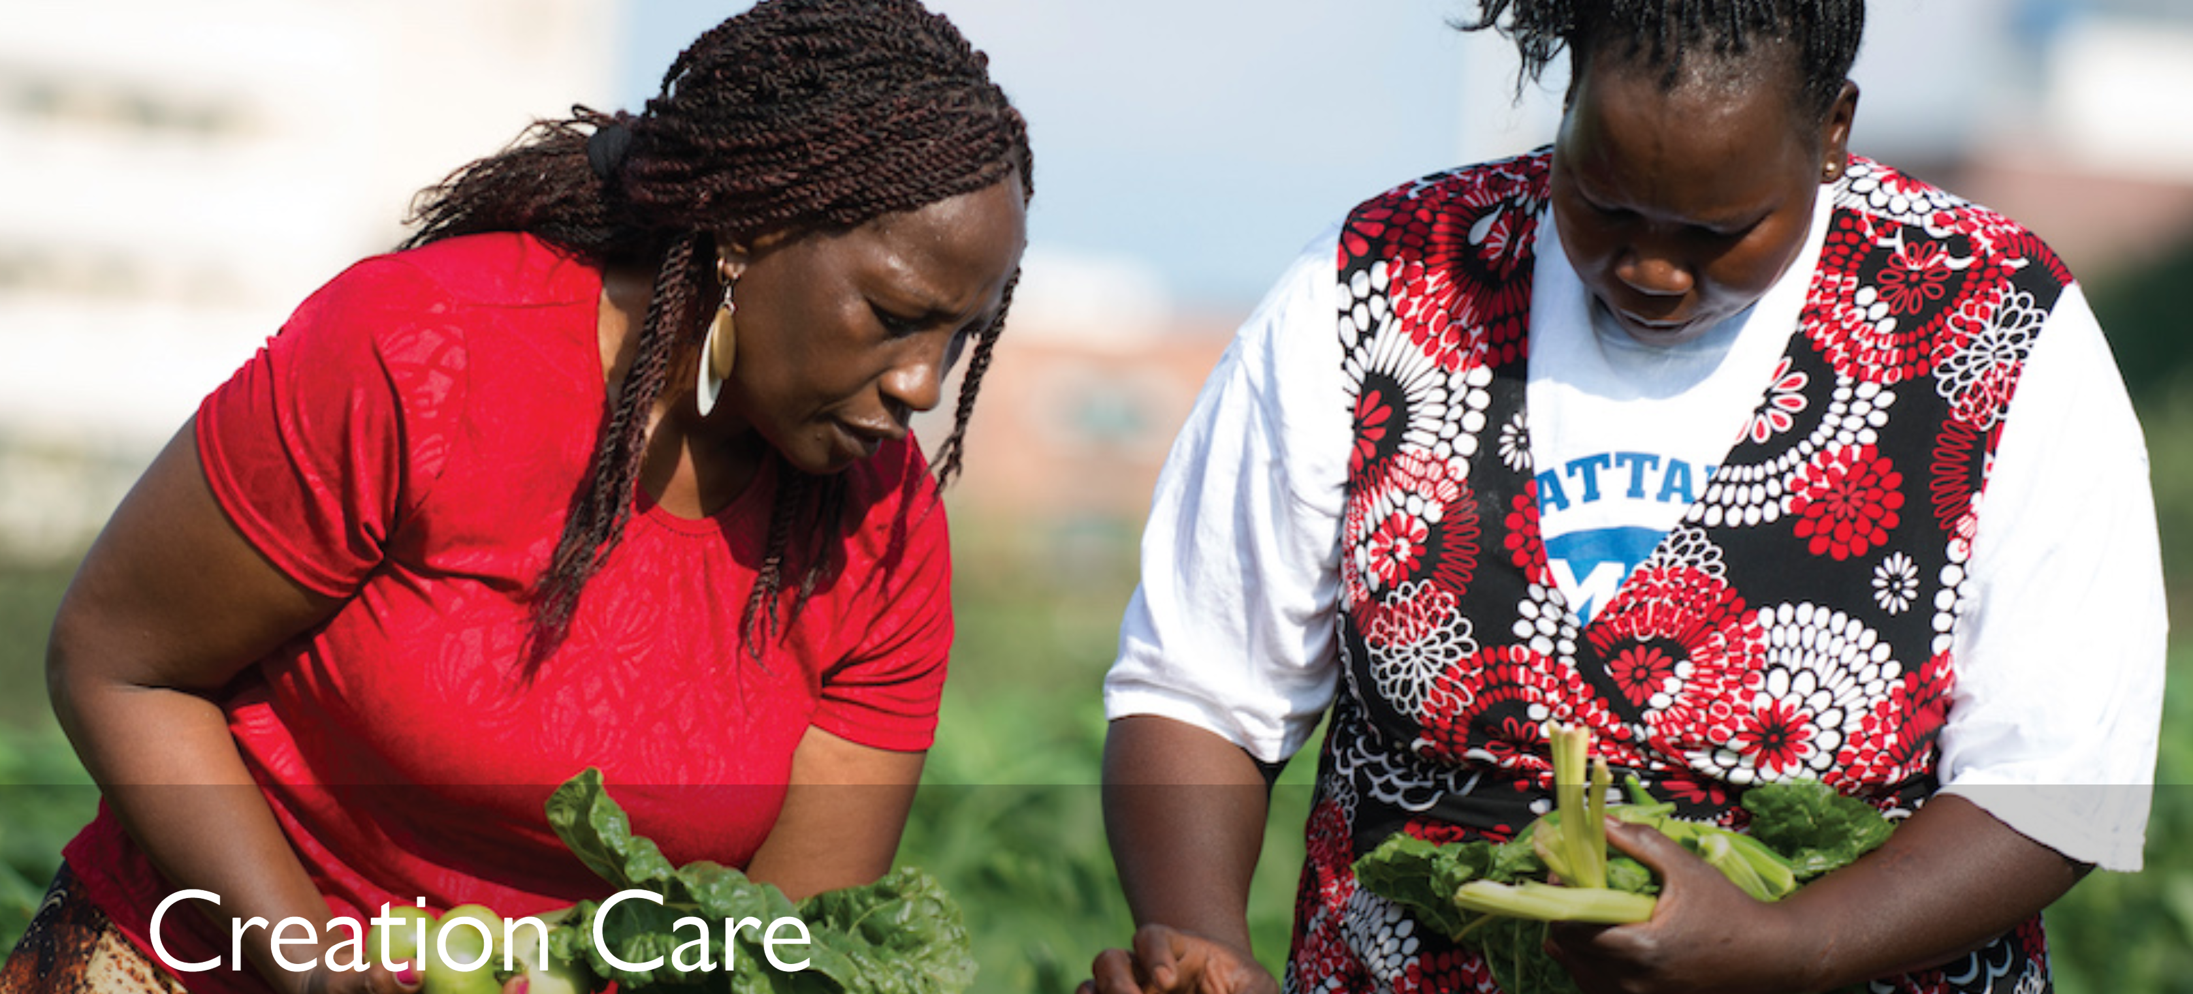
2022 HOUSE OF BISHOP’S CLIMATE STATEMENT
OUR FIRST VOCATION
FUTURE FOCUS
Together with God, together with one another, we care for God’s world
Address climate change for the sake of love of God and neighbor by:
Treating all human beings with dignity so droughts, floods, and extreme weather patterns don’t force people into exile and desperate, life-threatening migration.
Building peace so that competition for scarce resources does not drive further violence.
Ensuring that every child of God has enough to eat so that our bountiful earth can continue to support and sustain food systems that nourish people and the soil.
CURRENT STATE
We:
Crave and hoard what we do not need
Take and grasp what does not belong to us
Burden and dominate what was meant to be free
As a result, the planet and our most vulnerable neighbors suffer
Creation Care – The Episcopal Church
Expressing the Mind of the House on Climate and Our Vocation in Christ – The Episcopal Church

Slide 15

commitment
ACCELERATE AMBITION​
We urge ALL stakeholders – member states, private sector, civil society and individuals — to accelerate ambition and reduce carbon consumption and emissions to keep global warming to 1.5C degrees above pre-industrial levels. We urge member states to fulfill their Paris Agreement commitments and intensify the impact of Nationally Determined Contributions (NDCs), focusing particularly on nature-based solutions, sustainable cities and the blue economy. We applaud ambitious commitments by member states, including the U.S.’s new NDC of 50-52%.​
The Episcopal Church is committed to growing loving, liberating and life-giving relationships across the human family and with all of God’s creation.
INCREASE SUPPORT FOR COMMUNITIES EXPERIENCING LOSS AND DAMAGE​
We urge all stakeholders to “leave no one behind” in accordance with Agenda 2030 and the Sustainable Development Goals, by prioritizing and sustaining multilateral commitments to the most vulnerable populations. We urge member states to offer generous political and financial support for the Warsaw International Mechanism, including an accountable and effective governing structure. We encourage UN officials and negotiators to recognize the unique sectoral contributions of faithbased communities in confronting climate change and to work with them as they respond to the spiritual and psychosocial needs of those facing climate grief and trauma.
COP26-Episcopal-Church-policy-priorities-June-2021.pdf (episcopalchurch.org)

Slide 16
commitment
PROTECT HUMAN RIGHTS AND AFFIRM CLIMATE AND ECOJUSTICE
IN ADDRESSING ADAPTATION AND MITIGATION
As part of our own commitment to lead sustainable lives, The Episcopal Church is taking thoughtful action and making choices that right-size our impact on the Earth, bearing witness to the challenges facing our frontline communities, strengthening the adaptive resilience of climate-impacted peoples and supporting vulnerable populations coping with irreparable loss and damage.
We have introduced a churchwide Covenant for the Care of Creation that invites individuals, churches, dioceses and Episcopal institutions to commit to deeper formation, public advocacy, and mitigation.
Over 2,000 households and congregations are measuring carbon footprint via our Carbon Tracker.
We are setting and working to achieve church-wide goals for achieving carbon neutrality by 2050.
We are working on an ambitious reforestation project in Haiti and supporting forest protection in the Amazon.
We are planting “Good News Gardens” and partnering locally to improve access to good, affordable food.
We commend member states who have committed to adaptation and mitigation solutions and ask for swift action, significantly increased adaptation finance, progress towards the Global Goal on Adaptation, and support for multinational and multi-sectoral initiatives. We ask negotiators to affirm climate justice, reject environmental racism and prioritize the needs of the most vulnerable, including small island developing states and least developed countries, Indigenous peoples, climate migrants, youth and women (in accordance with the Gender Action Plan). We urge negotiators to design solutions that protect the human rights and authority of Indigenous peoples and local communities, respecting the principle of Free Prior and Informed Consent mandated by the UN Declaration on the Rights of Indigenous Peoples. We ask negotiators to ensure a just transition for fossil-fuel dependent communities.
BOOST CLIMATE FINANCE AND MECHANISMS​
We urge member states to fulfill their financial pledges to the Green Climate Fund and other climate finance mechanisms and to enhance their reporting capacities in order to improve honest tracking, transparency and accountability. We support the $100 billion mobilization goal..
COP26-Episcopal-Church-policy-priorities-June-2021.pdf (episcopalchurch.org)

Slide 17
GOALS
Enacting churchwide resolutions and policies on climate change, environmental issues and sustainable development
Participating annually at COPs from the Paris Agreement forward
The Episcopal Church’s governing bodies affirmed support for the Paris Agreement and Agenda 2030’s Sustainable Development Goals in 2016. In 2018, our governing bodies passed 19 resolutions relating to creation care, from adaptation projects to fossil fuel divestment, carbon tracking to sequestration, ending environmental racism and supporting the rights and needs of Indigenous peoples and women.
Beginning with COP21 in 2015, The Episcopal Church’s Presiding Bishop has sent delegations to the annual UN Climate Change Conferences to advocate for strong and just climate policies. The Church also educates Episcopalians about the COP negotiations and advocacy opportunities to facilitate their engagement with Paris Agreement goals in their homes, communities and churches.
Partnering with the United Nations, UNFCCC and UNEP as an observer​
Collaborating with ecumenical, interfaith and civil society partners.​
The Episcopal Church is a Christian denomination with 2 million members in more than 15 countries in North America, Latin America & the Caribbean, Europe, Asia and the Pacific. It enjoys ECOSOC accreditation and DGC association with the UN, and observer status with the UNFCCC (since 2017) and UNEP (since 2020). The Church promotes environmental priorities across various UN frameworks and meetings, including the United Nations Commission on the Status of Women, the Permanent Forum on Indigenous Issues and the High-Level Political Forum on the Sustainable Development Goals.
As a member province of the worldwide Anglican Communion (third largest Christian communion, with 85 million members in 165 countries), The Episcopal Church joins with Anglican and other faith-based partners in supporting spiritual approaches to climate action and advocating for climate friendly policies and practices, including GreenFaith, Interfaith Power and Light, ecoAmerica, and Creation Justice Ministries. At COP26, The Episcopal Church is partnering with the Anglican Communion, ACT Alliance/ World Council of Churches/Lutheran World Federation ecumenical delegation, and the Interfaith Liaison Committee for the sake of joint advocacy, social witness, prayer and worship.
COP26-Episcopal-Church-policy-priorities-June-2021.pdf (episcopalchurch.org)

Slide 18
GOALS (continued)
Accelerating ambition targets
Promoting adaptation and mitigation
Helping people face Loss and Damage
The Episcopal Church has raised ambition towards implementing renewable energy and energy efficiency through resolutions and is developing a churchwide ambition as part of our Creation Covenant.
The Episcopal Church funds projects to advance climate change education, advocacy and adaptation, and awards grants to ministries undertaking innovative environmental work. Between 2015 and 2021, the Church has allocated $1.5 million for ecojustice work, pioneering networks, educational initiatives, and programmatic engagement around environmental stewardship. The Episcopal Church also supports the development of a Carbon Tracker, designed by the Diocese of California to mobilize individuals, households, faith communities and the whole church for climate action
Episcopalians follow Jesus’ example in prioritizing concern for the most marginalized and vulnerable. As more and more people suffer from climate-induced Loss and Damage, the Church is providing hope and practical action, offering teachings on faith and creation, hosting community centers for action and refuge, and offering trauma counseling, liturgies, prayer and spiritual support for climate grief.
Supporting the Green Climate Fund
The Episcopal Church has urged support for the Green Climate Fund in past years through its Episcopal Public Policy Network (EPPN), a network of Episcopalians that organizes grassroots advocacy efforts directed toward U.S. government officials. We are currently asking the U.S. to fulfill its unmet $2 billion pledge.
Standing with communities at risk
The Episcopal Church is a strong partner in the Faith for the Arctic Network, a diverse coalition of religious organizations committed to permanently safeguarding the Arctic National Wildlife Refuge and supporting the Gwich’in people, an Indigenous Alaskan population heavily impacted by climate change. The Church also supports fossil-fuel dependent communities, understanding that a just transition must account for their needs.
COP26-Episcopal-Church-policy-priorities-June-2021.pdf (episcopalchurch.org)

Slide 19
Resiliency & RESTORATIVE JUSTICE

Slide 20

RESILIENCY
Food & energy security
Economic Stability
Neighborhood & Physical Environment
Community & Social Context
Education
Healthcare Access & Quality
Six Social Determinants of Community & Individual Health
Beyond Health Care: The Role of Social Determinants in Promoting Health and Health Equity | KFF
RESILIENCE is the ability of people and their communities to anticipate, accommodate and positively adapt to or thrive amidst changing climate conditions and hazard events. Resilient communities enjoy a high quality of life, reliable systems, and economic vitality, and they conserve resources for present and future generations.
USDN_ResilienceHubsGuidance-1.pdf

Slide 21

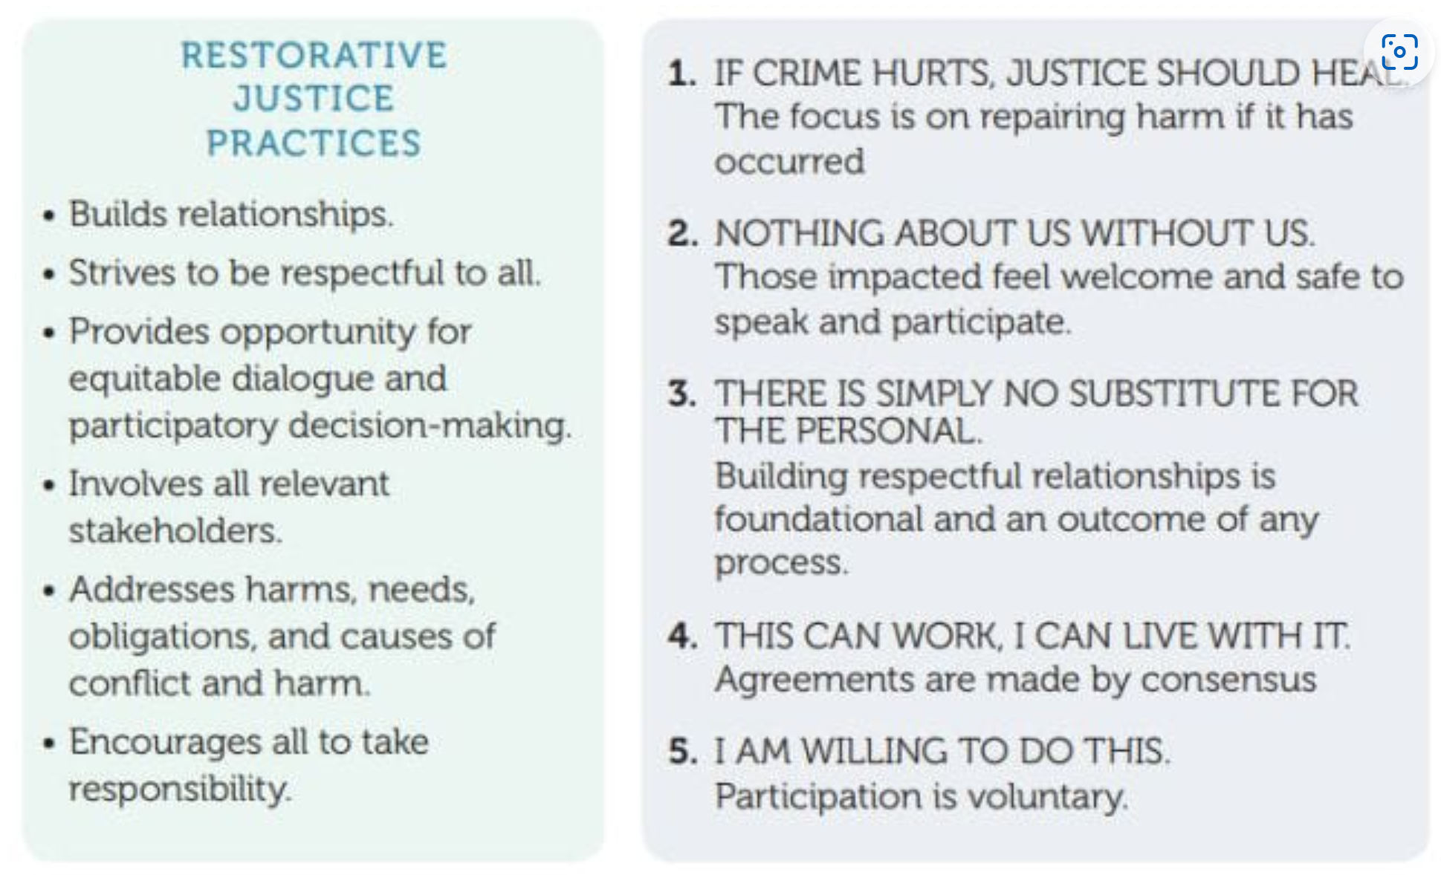
RESTORATIVE JUSTICE
Restorative justice is a theory of justice that focuses on mediation and agreement rather than punishment. Offenders must accept responsibility for harm and make restitution with victims. Indigenous people like the Maori have used this system successfully in their communities for generations.
The Church is on the ancestorial lands of Native American and indigenous people
The Church is rich in real estate often located in high-income communities surrounded by struggling communities
Becoming a resiliency hub not only meets present-day needs for disaster preparedness but can serve as a means to address past transgressions and become a vehicle for restorative justice
What Is Restorative Justice in Schools? (weareteachers.com)

Slide 22

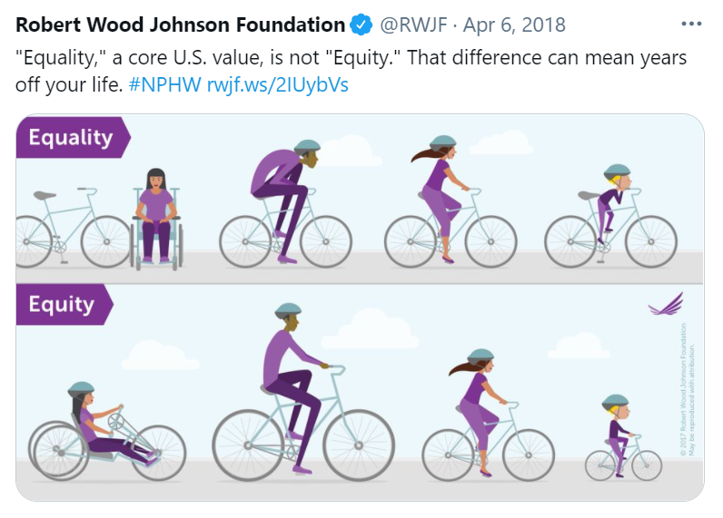
Equity
Equity is not equality
Equality
Each individual or group of people is given the same resources or opportunities.
FAIRNESS
Impartial and just treatment or behaviors without favoritism or discrimination.
Equity
Recognizing that each person has different circumstances and allocates the exact resources and opportunities needed to reach an equal outcome.

Slide 23

EQUITY ICEBERG
Prosperity
Sustainable business success & reinvestment
Ability to sustain setbacks & losses
Access to capital
Network & sponsors
INTERSECTIONAL NEEDS
Influenced by unconscious Bias
Saving & investing
Budgeting & managing cash flow
Systematic discrimination and unconscious bias contribute to the current state of vulnerable communities
Lower deficit needs must be addressed before higher needs can be addressed
Conditions in the environment where people are born, live, learn, work, play, and age affect their health, functioning, and quality-of-life outcomes and risks
COMMUNITY VS HUMAN CENTERED DESIGN
Poverty
Majority white culture put a premium on the role of individuals to solve problems
Solving for a clean energy future in vulnerable communities requires community centered design and solutions
Employment & standard of living
Education & access to technology
Environment & pollution level
Personal & neighborhood safety
Family stability & homelife
Health & access to care
Shelter, warmth & sanitation
The equity iceberg: What you need to know about serving the underserved (esource.com)
Influenced by Systematic Discrimination
Food & energy security

Slide 24
Church as resiliency hub

Slide 25
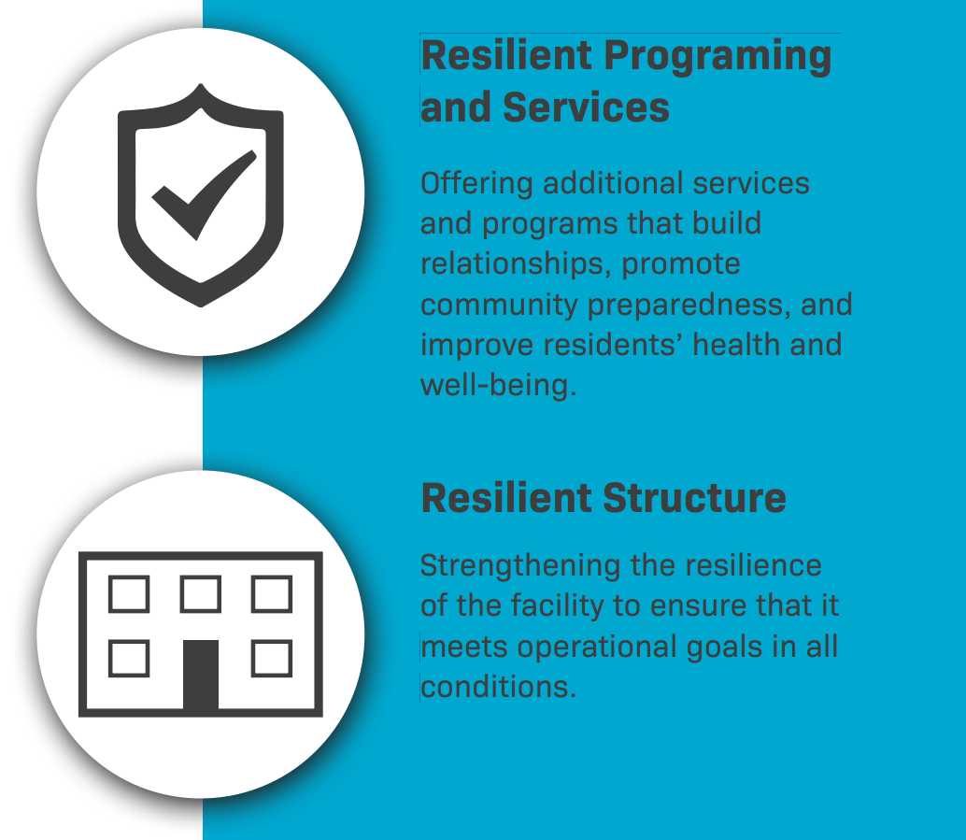
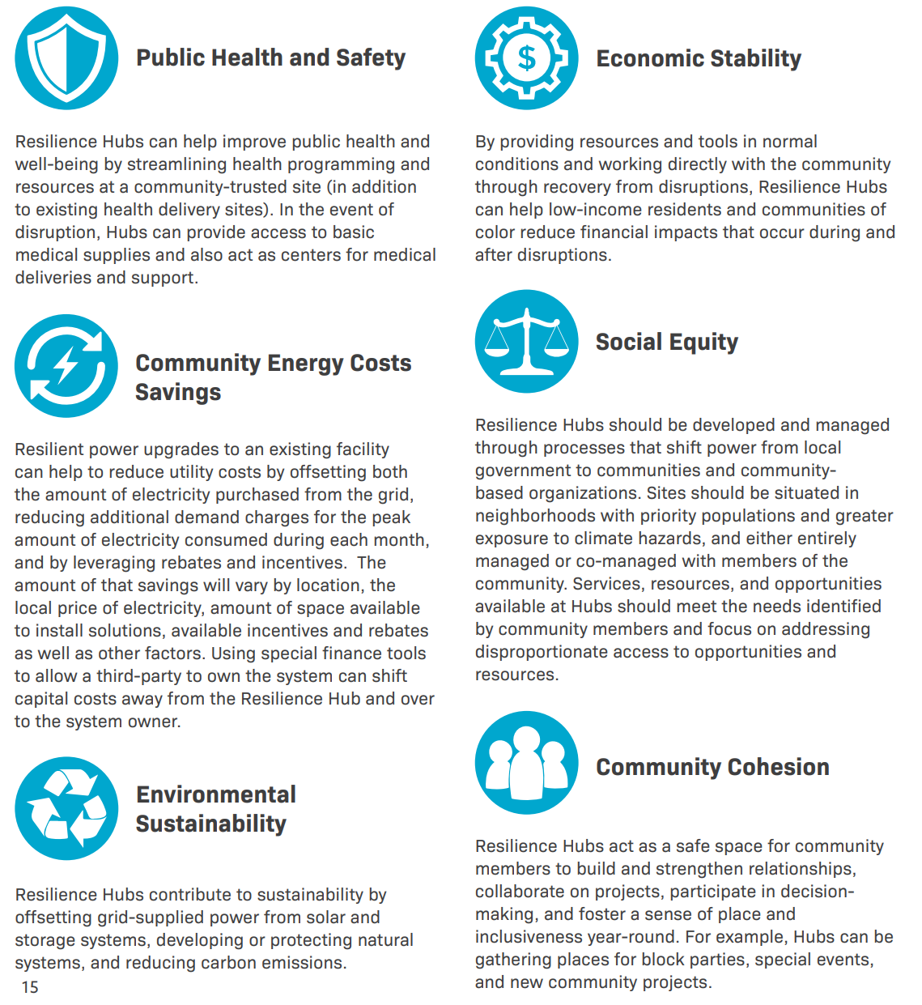
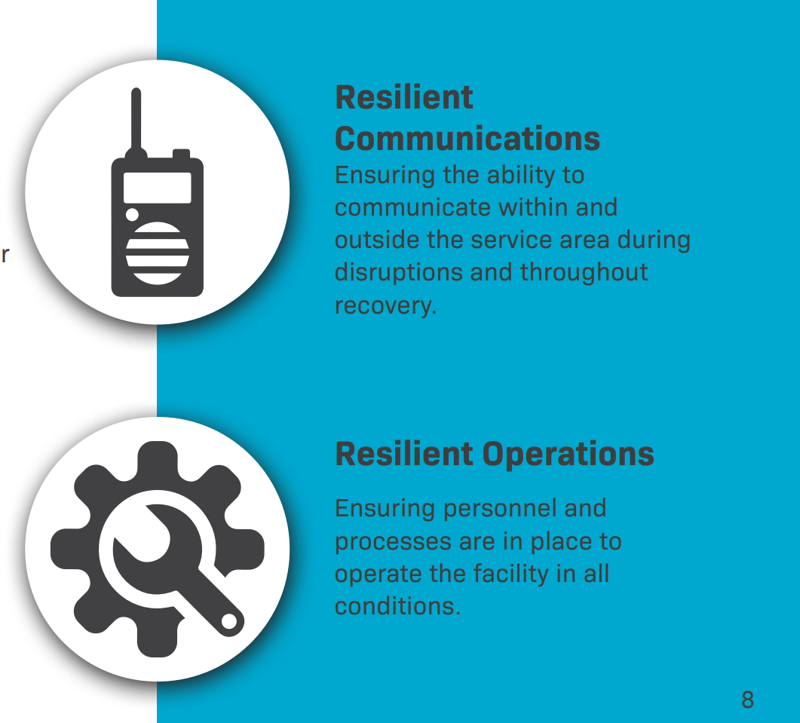
WHAT IS A RESILENCY HUB
RETURN ON INVESTMENT
RESILIENCE HUBS use a physical space - a building and its surrounding infrastructure - to meet numerous goals, both physical and social. Resilience hubs are an opportunity to efficiently improve emergency management, reduce climate pollution and enhance community resilience. These spaces also provide opportunities for communities to become more self-determining, socially connected, and successful in the long-term. This document outlines initial thinking about essential elements of a Resilience Hub and how to begin planning for Hub development.
USDN_ResilienceHubsGuidance-1.pdf

Slide 26




Resiliency hub
ENERGY SECURITY
SOCIAL HOUSING
FOOD SECURITY & EMPLOYMENT
EMERGENCY & COMMUNITY CENTER
Shelter from extreme weather, wildfire, earthquake and other human or natural disasters
Renewable energy generation, storage and microgrid that powers church and surrounding communities
Free energy to poor
Social housing for struggling communities that’s net zero, passive solar with storage
Food collection, growing, processing and distribution to address community hunger, provide employment and decrease carbon emissions

Slide 27
EMERGENCY & COMMUNITY CENTER
CLIMATE CONNECTIONS
Emergency
RECOVERY
Dr. Lucy Jones and Mary Nichols road show, disaster preparedness planning training and template materials:
In the event of a disruption, Hubs will switch from Normal Mode into reacting and responding to the disruption and will enhance operations to better support immediate community needs. With enhanced systems and capacity, Hubs can ideally help reduce the need of emergency services and better connect residents and businesses with supplies, information and support during a disruption.
After disruption, Hubs are ideally intended to switch into Recovery Mode. The same inequities frontline communities experience before and during a disaster tend to impact their ability to recover, let alone thrive, after a disruption. Hubs can act as centers for resource deliveries and distribution, access to support and assistance for complicated processes such as filling out relief or insurance forms, locations to access support services for trauma and can even be locations where Community Benefits Agreements are generated. Hubs can also be central locations for external partners to gather and support recovery services such as conducting needs assessments, damage assessments, interviews with residents, and collecting data.
Individual Preparedness Initiatives
Resilience Workshops and Table Top Exercises
Climate and Response Trainings
Asset and Shortcomings Mapping and Needs Assessments
Communications and Outreach

Slide 28
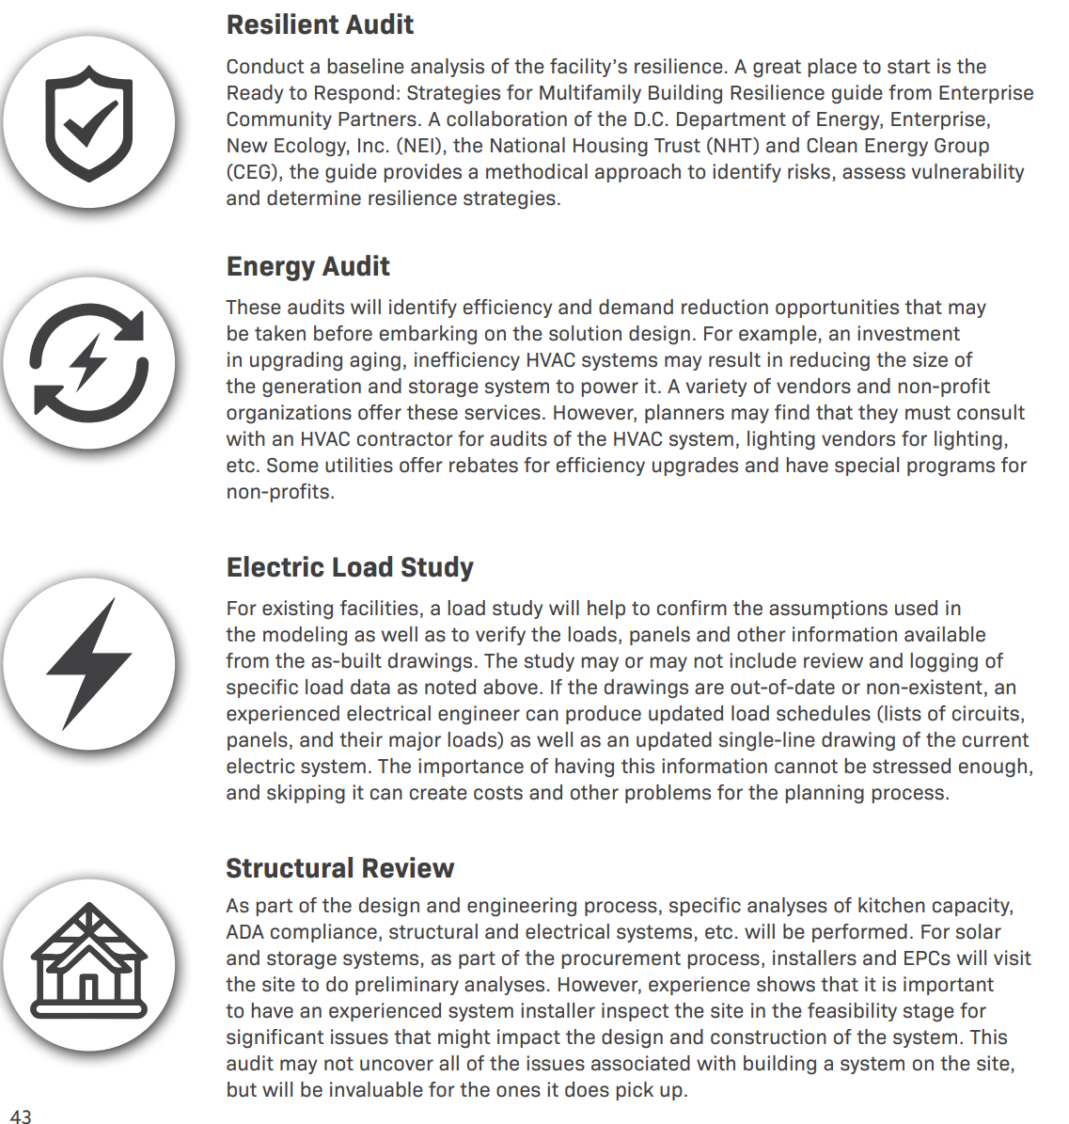
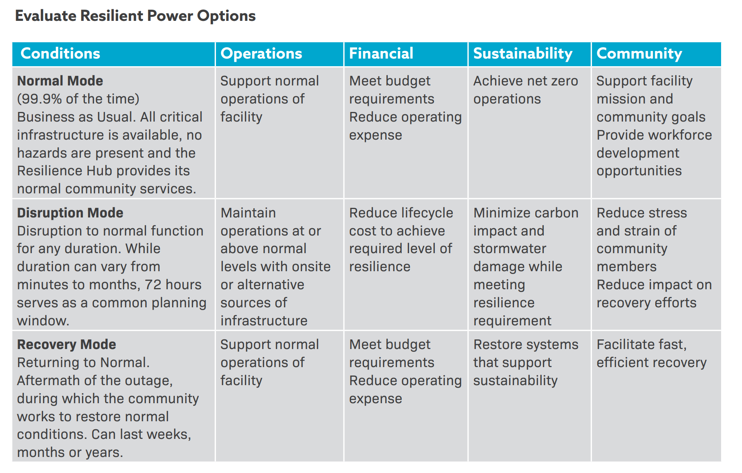
ENERGY SECURITY

Slide 29
SOCIAL HOUSING
First net-zero church and social housing project in Canada
A few years back, then-minister of Westmount Presbyterian Church Reverend Annabelle Wallace and her congregation gathered together to decide what to do about their 1950s-era cinder block church. With its poor insulation, seven furnaces, unsustainable heating bills and the ever-increasing list of repairs the first step was to take stock of their core values.
The congregation couldn’t afford to fix their church, let alone pay the utilities in their big old inefficient church. Reverend Wallace and her congregation embarked on an incredible journey. First, they took stock of their assets. Then they devised a plan to address everything they care about: their church, the environment, homes for refugees and the diversification and revitalization of their community.
Cash-poor and land-rich the church cut a deal with the the Right at Home Housing Society. In exchange for a free lease the housing society agreed to build 16 units of housing for refugees and a new church on church land.
Net-zero and social housing go hand-in-hand.
Not only does the new development completely eliminate the Church’s heating issues—their utility bills are now almost nil—it also answered a desperate need for affordable housing for newcomers to Edmonton. By creating space to welcome young families to the neighbourhood, the church and social housing development also just happened to solve an urgent enrolment shortage at the neighbouring Coronation School.
237. God's green home is net-zero - Green Energy Futures

Slide 30
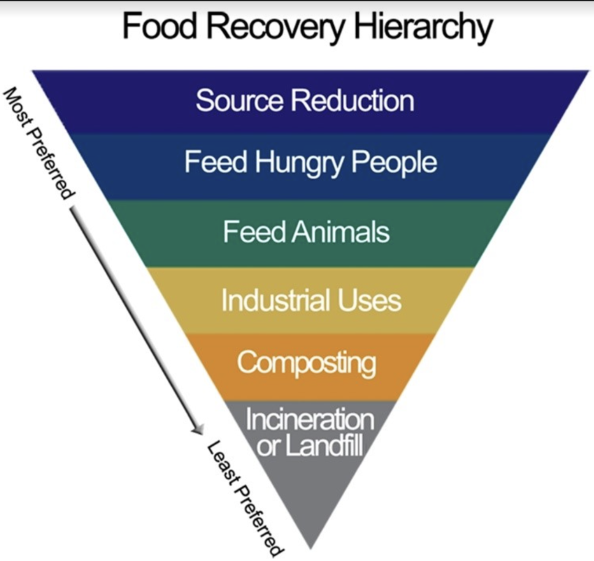
FOOD SECURITY & EMPLOYMENT
Between 30 to 40% of what landfill in the US goes to food waste. SB 1383 is a potential source of funding if we wanted to expand Food Locker operations to take on a broader role in this area. Although Food Locker is important, it was not deemed a primary ministry of the church (i.e. it was allowed to operate so long as it didn't interfere with other things). So the decision was made to continue operating under Union Station's umbrella in receiving food from Vons / Pavilion's instead of absorbing the administrative burden of operating separately (i.e. Union Station / Holy Family, etc have paid staff through the church as opposed to Food Locker, which is entirely volunteer). Food Locker operations are intersectional to other areas of interest to the Climate Committee (see USDA graphic below). I forward this all as "food for thought" as we center on actions.
As of now, there are a couple of ways we handle Food Locker food waste:
Whatever is not distributed on the Fridays goes with one of our guests to the Dream Center (a local homeless encampment)
In high season for Farmers Market / summer and times when we get a lot of overly ripe but not rotten produce, we have engaged Lions Heart Girls and the SPMS Home Ec teacher to can items and produce pasta sauces and jams. We operate under the Good Samaritan's agreement so technically we can distribute it through the Food Locker, but the decision was made by administration not to distribute.
What is too rotten to pass on ends up in the dumpster
SB 1383

Slide 31
FUNDING

Slide 32
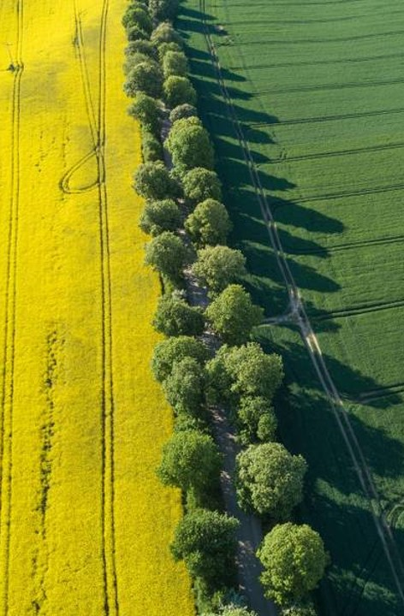
GRANT FUNDING
UTILITY PARTNERSHIPS & FUNDING
EPA Environmental and climate justice block grant program
EPA is seeking public input to shape the program. Position the church as a resiliency hub in climate action landscape
As utilities migrate their energy mix to renewables, the church could be a strategic partner in emergency preparedness, disaster recovery and energy resiliency
The church and utilities have a shared responsibility to advance energy equity and restorative justice in climate action
GRANTS
Utilities grants for energy resiliency, sustainable building, environmental and climate justice and including vulnerable communities in a clean energy future

Slide 33
EPA Environmental and climate justice block grant program
RFI RESPONSE DUE: 11:59 PM ET on March 17, 2023
Through this Request For Information (RFI), EPA invites the public to comment on the ECJ Program. EPA may use responses received to assist in developing ECJ Program design, structure, and guidance.
Environmental and Climate Justice Block Grant Program (ECJ Program), created by the Inflation Reduction Act (IRA) under Clean Air Act (CAA) Section 138:
Provides funding for financial and technical assistance to carry out environmental and climate justice activities to benefit disadvantaged communities.
  $2.8 billion for financial assistance
  $200 million for technical assistance, to implement this new program at the Environmental Protection Agency (EPA)
EPA is seeking new and innovative strategies and approaches for:
Competition design
Community engagement
Equitable distribution of 2 financial resources
Grantee eligibility for funding, capacity-building and outreach, and technical assistance
Submit your comments: identified by Docket ID No. EPA-HQ-OEJECR-2023-0023 to the Federal eRulemaking Portal: www.regulations.gov. Follow instructions on the website for submitting comments
EPA must award grants and technical assistance under the ECP Program by September 30, 2026.
237. God's green home is net-zero - Green Energy Futures

Slide 34
Advancing Racial Equity And Support For Underserved Communities Through The Federal Government
EPA’s efforts also support Executive Order 13985, Advancing Racial Equity And Support For Underserved Communities Through The Federal Government, issued on January 20, 2021
Comprehensive approach to advancing equity for all, including people of color and others who have been historically underserved, marginalized, and adversely affected by persistent poverty and inequality
  “Underserved Communities” as “populations sharing a particular characteristic, as well as geographic communities, that have been systematically denied a full opportunity to participate in aspects of economic, social, and civic life…”.
  Includes communities such as Black, Latino, and Indigenous and Native American persons, Asian Americans and Pacific Islanders and other persons of color; members of religious minorities; lesbian, gay, bisexual, transgender, and queer (LGBTQ+) persons; persons with disabilities; persons who live in rural areas; and persons otherwise adversely affected by persistent poverty or inequality
  Underserved communities may also include environmentally overburdened communities which are communities adversely and disproportionately affected by environmental, climate, and human health harms and risks, including remote, rural, and urban communities, and disadvantaged communities.
237. God's green home is net-zero - Green Energy Futures

Slide 35
Justice40
EPA’s activities also support Executive Order 14008, Tackling the Climate Crisis at Home and Abroad, issued on January 27, 2021, which deepened the Administration’s commitment to advancing environmental justice by creating the Justice40 Initiative.
The Justice40 Initiative establishes a goal that 40% of the overall benefits of certain federal investments flow to disadvantaged communities, including:
Climate change
Clean energy and energy efficiency
Clean transit
Affordable and sustainable housing
Training and workforce development
Remediation and reduction of legacy pollution
Development of critical clean water infrastructure
EPA’s Definition of Environmental Justice
The fair treatment and meaningful involvement of all people regardless of race, color, national origin, or income with respect to the development, implementation, and enforcement of environmental laws, regulations, and policies
Fair treatment means that no one group of people, including racial, ethnic, or socioeconomic groups, should bear a disproportionate share of the negative environmental consequences resulting from industrial, municipal, and commercial operations or the execution of federal, state, local, and tribal environmental programs and policies. Meaningful involvement means that: • People have an opportunity to participate in decisions about activities that may affect their environment and/or health; • The public's contribution can influence the regulatory agency's decision; • Community concerns will be considered in the decision-making process; and • Decision makers will seek out and facilitate the involvement of those potentially affected
237. God's green home is net-zero - Green Energy Futures

Slide 36
Hydrogen

Slide 37
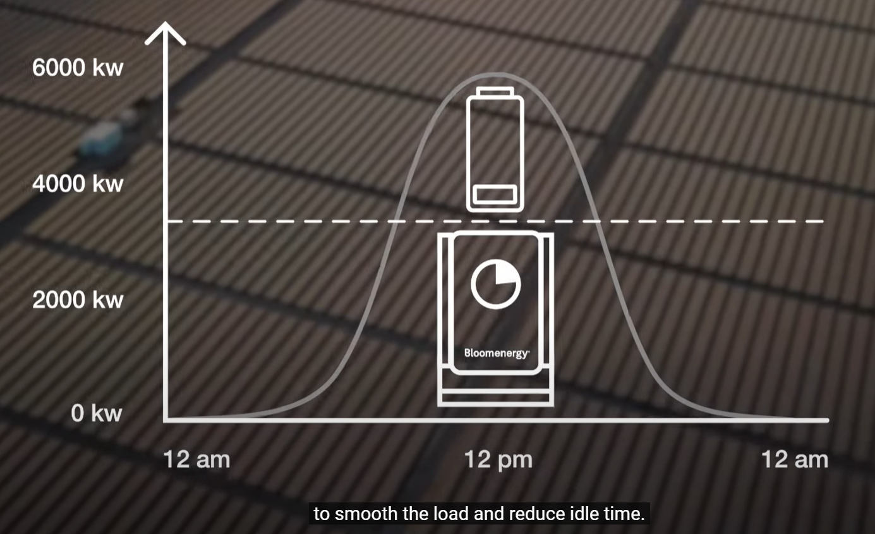
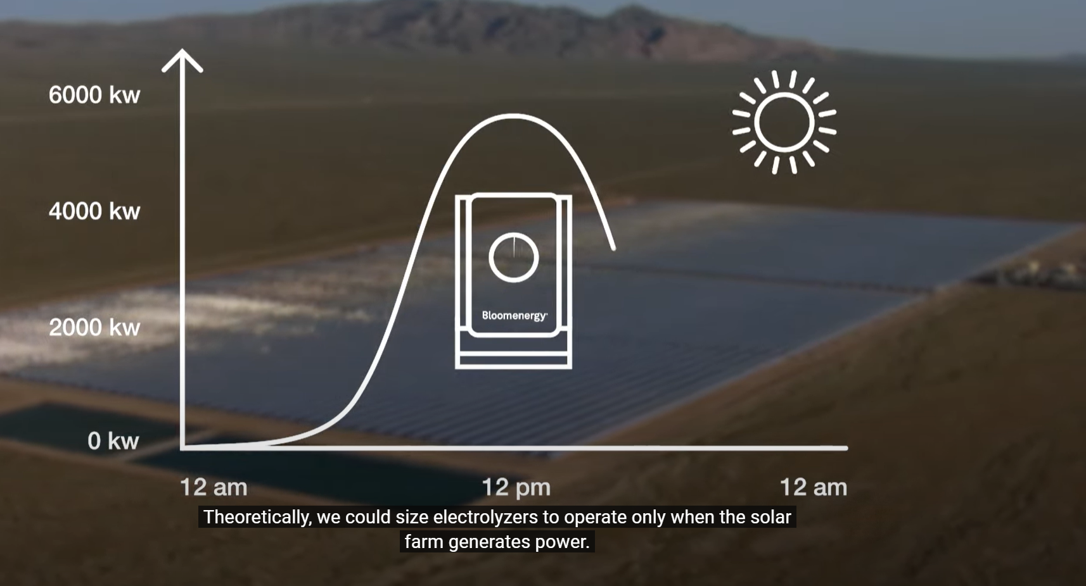
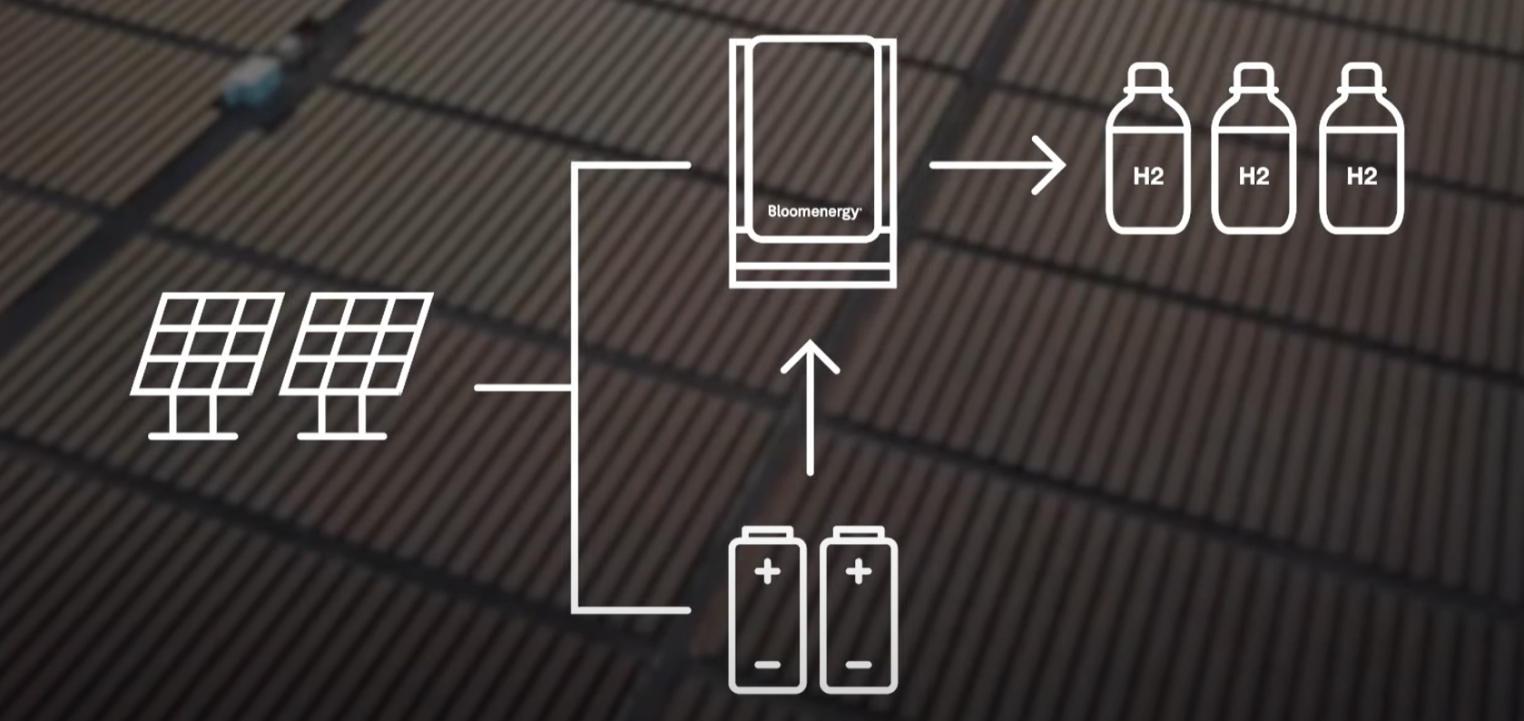

SOLAR
HYDROGEN
(75) The Bloom Guide to Hydrogen | Bloom Energy - YouTube
Solar is only produced when the sun is shining. Storage technology is costly and ineffective.
On-Call Environmental Consulting Services (southpasadenaca.gov)

Slide 38
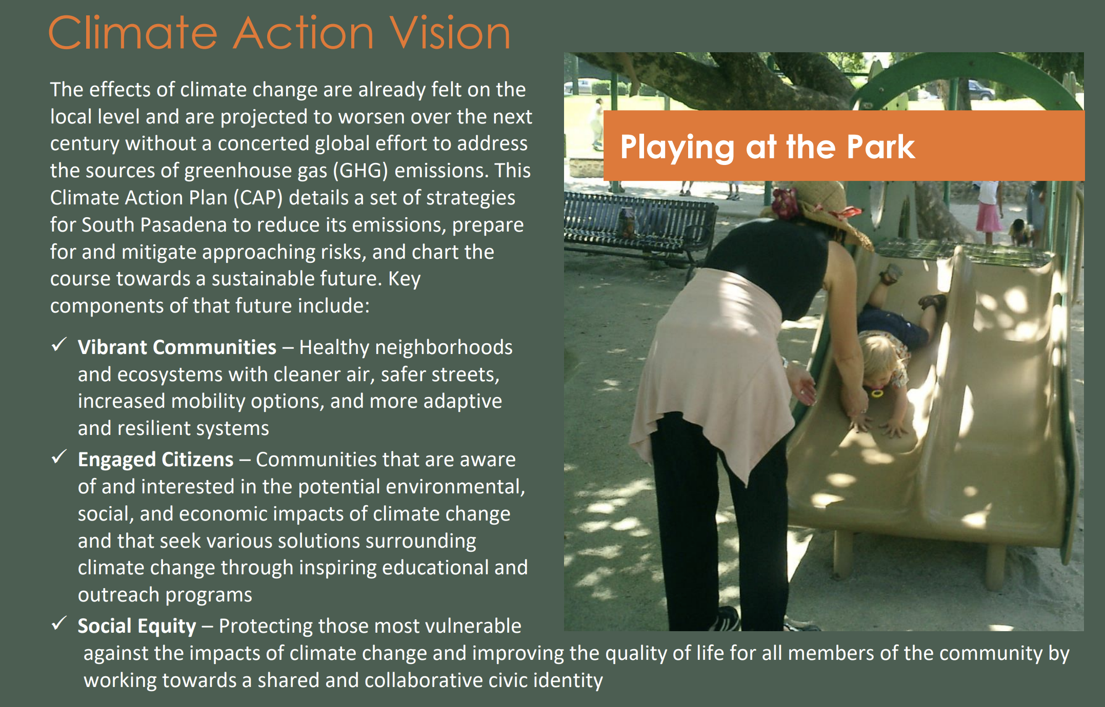
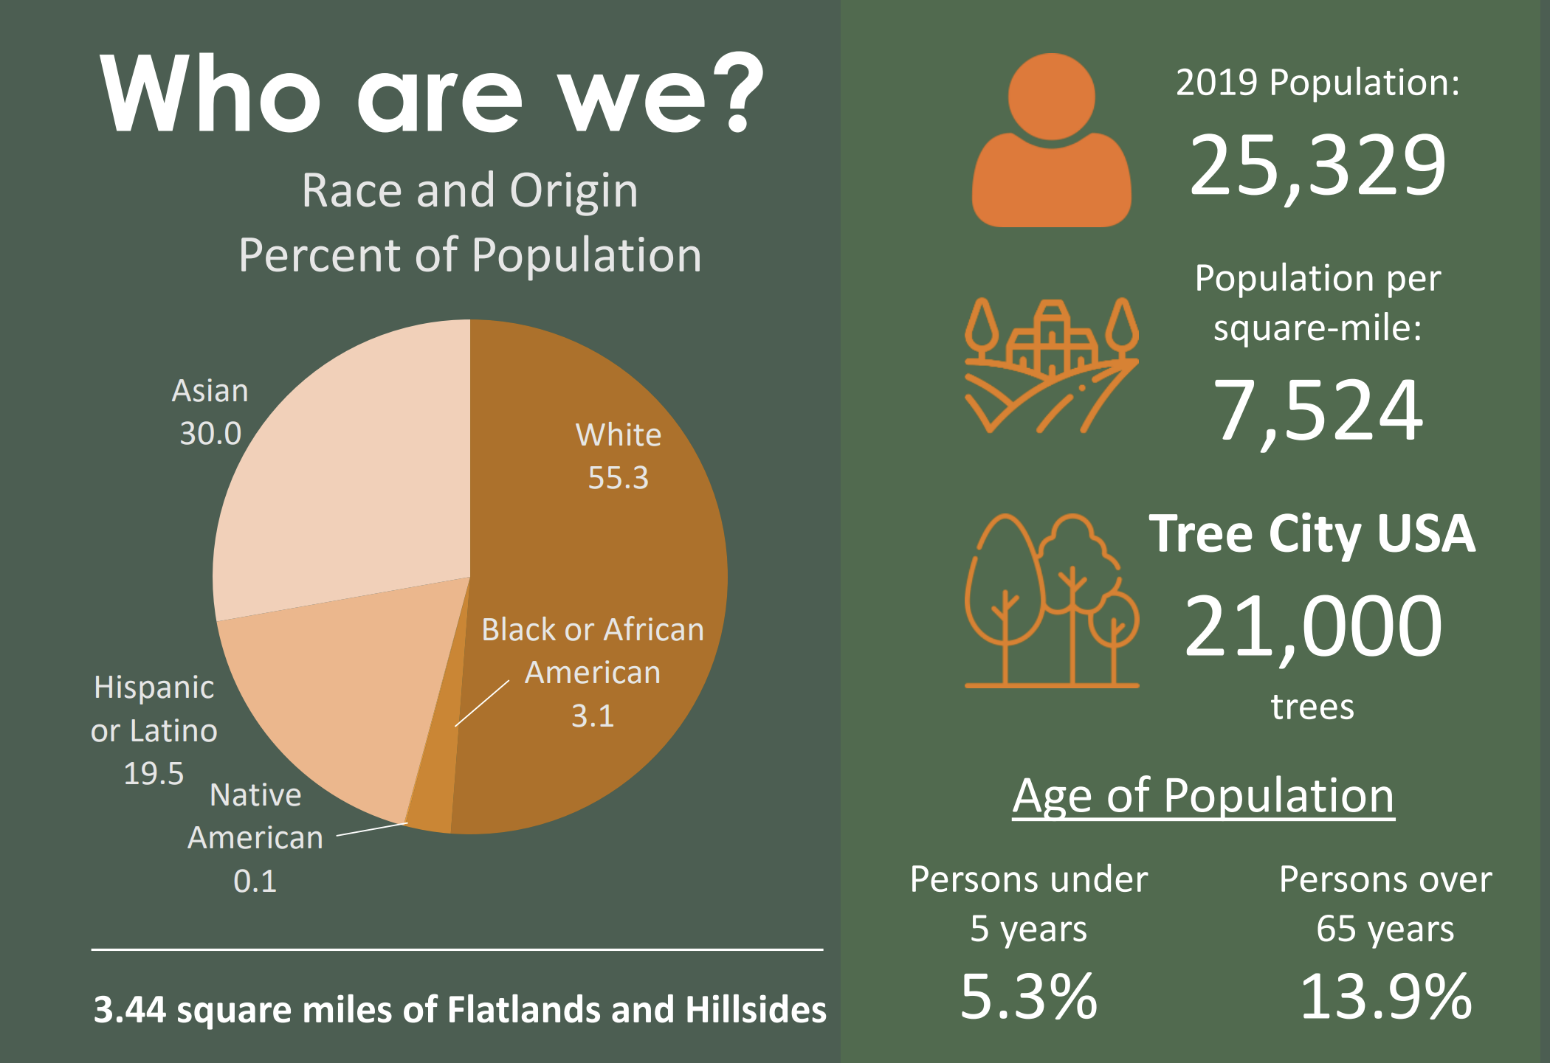
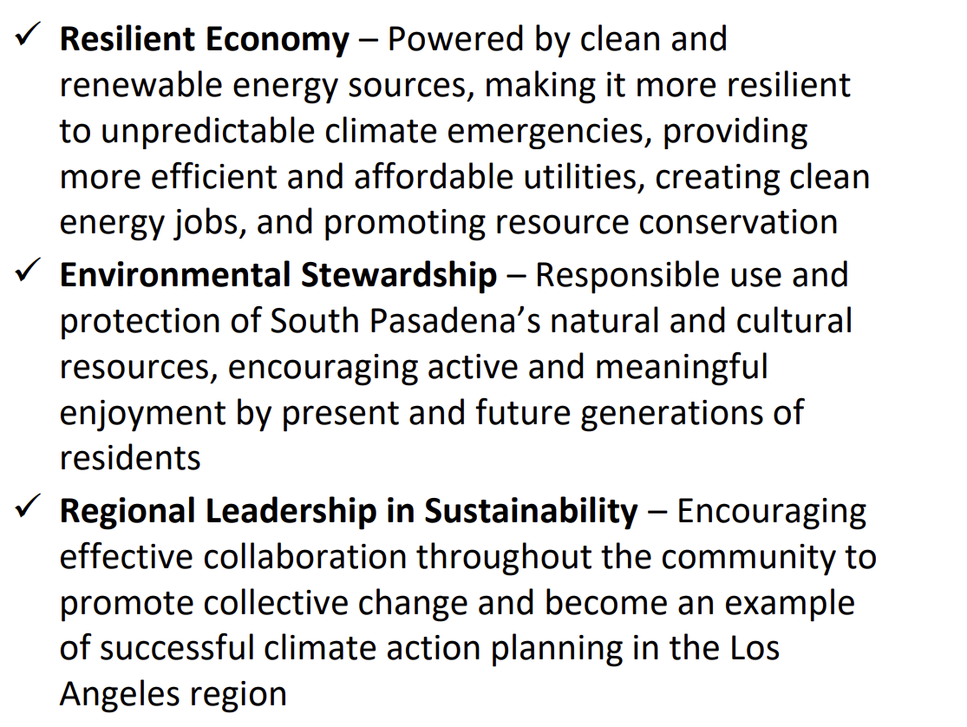
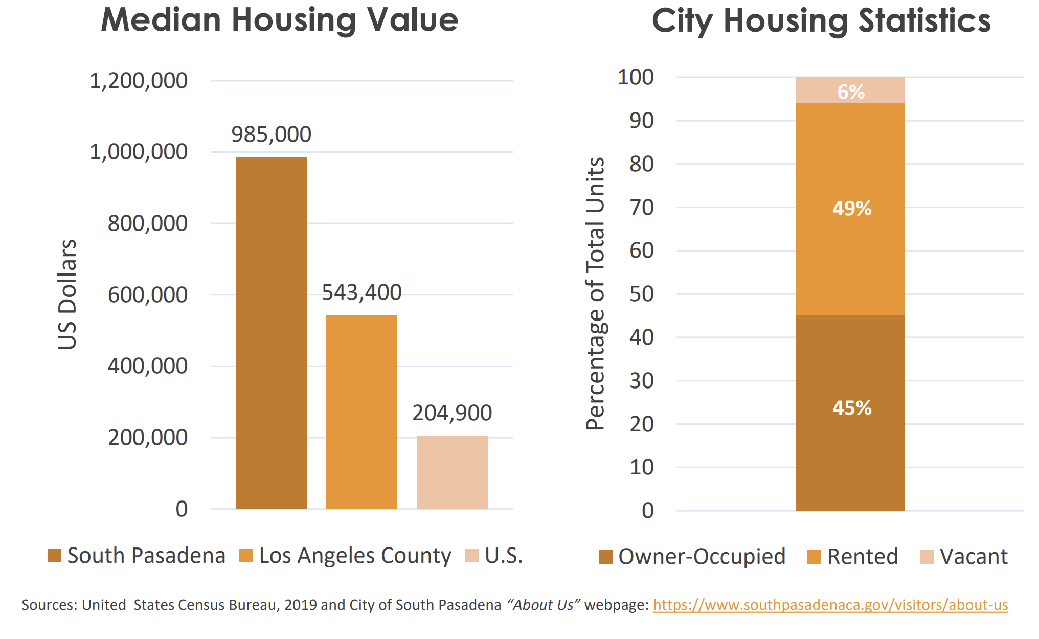
South Pasadena
On-Call Environmental Consulting Services (southpasadenaca.gov)

